Slide 1
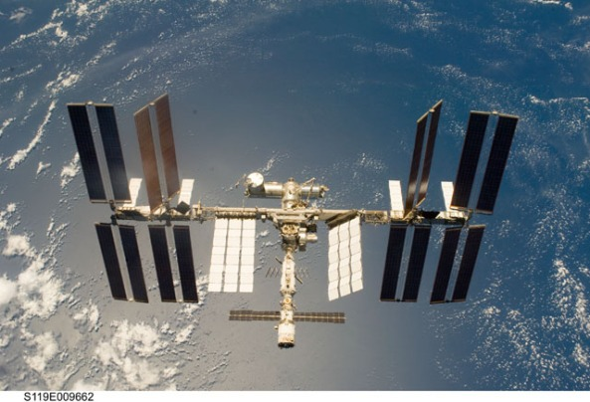

Slide 2
Play You Tube Video
https://youtu.be/KaOC9danxNo
Play intro and then skip to 3:20

Slide 3
History
The first Amateur Radio equipment was delivered to the International Space Station (ISS) in September 2000 and an Amateur Radio station was established onboard for use by Astronauts who are licenced Radio Amateurs. Commander William Shepherd, KD5GS, made the first Amateur contacts in November of that year.
Most of the astronauts on the International Space Station are licenced Radio Amateurs and sometimes during their spare time they talk to other Radio Amateurs back on earth. There is a special thrill in talking to an astronaut out in space!
.

Slide 4
Listening Online
If you don’t have an amateur radio receiver you can still listen to the ISS by using an Online Radio, also known as a WebSDR. Select a Frequency of 145800.0 kHz and Mode FM: • Farnham WebSDR when ISS is in range of London http://farnham-sdr.com/ • R4UAB WebSDR when ISS is over Russia http://websdr.r4uab.ru/ Check the N2YO site to see when the ISS is in range https://n2yo.com/?s=25544&df=1

Slide 5
Much of the time the Space Station equipment operates in “automatic mode”. It can act as an AX.25 APRS Packet Repeater, voice repeater or transmit Slow Scan Television (SSTV) pictures. Voice and SSTV transmissions take place on 145.800 MHz FM, the AX.25 packet may be heard on 145.825 MHz FM. (Note: Packet digipeater is no longer active)

Slide 6
When the astronauts put out a CQ call they also use 145.800 MHz FM but operate “split” listening for replies 600 kHz lower on 145.200 MHz. If you are lucky and hear them calling CQ just remember to activate your rigs repeater shift to ensure you reply on the correct frequency. You should never transmit on 145.800 MHz.

Slide 7
When to listen
The ISS is in a very low orbit and so is only in range 5 or 6 times each day and then only for a maximum of 10 minutes on the best orbit. This means you need to make sure you’re listening at the right time to hear it. There are a number of websites that tell you when to listen such as the N2YO site.

Slide 8
Doppler Shift
Astronaut Sunita Williams KD5PLB on the ISS
The International Space Station is traveling around the Earth at over 28,000 km/h. This high speed makes radio signals appear to shift in frequency, a phenomenon called Doppler Shift.
This Doppler shift will cause the ISS transmit frequency of 145.800 MHz to look as if it is 3.5 kHz higher in frequency, 145.8035, when ISS is approaching your location. During the 10 minute pass the frequency will move lower shifting a total of 7 kHz down to 145.7965 as the ISS goes out of range. To get maximum signal you ideally need a radio that tunes in 1 kHz or smaller steps to follow the shift but in practice acceptable results are obtained with the radio left on 145.800 MHz.

Slide 9
The IORS was launched from Kennedy Space Center on March 6, 2020, on board the SpaceX CRS-20 resupply mission. It consists of a special, space-modified JVC Kenwood D710GA transceiver, an ARISS developed multi-voltage power supply, and interconnecting cables.

Slide 10
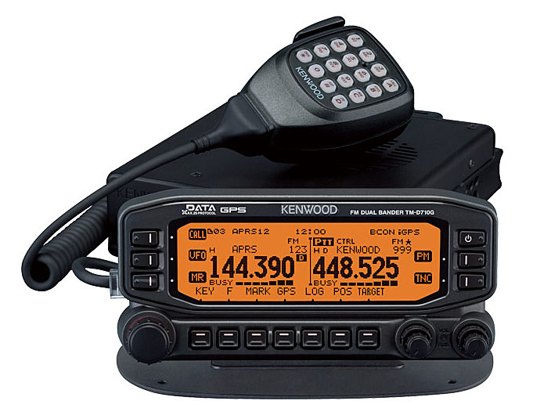

Slide 11
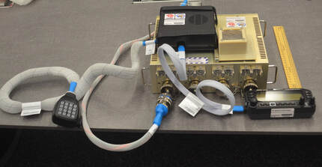

Slide 12
Voice Repeater system is operating on the International Space Station! Here is the access information:
Mode: FM Voice
Uplink Frequency: 145.990 MHz, PL 67.0 Hz
Downlink Frequency: 437.800 MHz

Slide 13
The design, development, fabrication, testing, and launch of the first IORS was an incredible five-year engineering achievement accomplished by the ARISS hardware volunteer team. It will enable new, exciting capabilities for ham radio operators, students, and the general public. Capabilities include a higher power radio, voice repeater, digital packet radio (APRS) capabilities, and a Kenwood VC-H1 slow-scan television (SSTV) system…

Slide 14
A set of four antenna systems are deployed on the ISS Service Module supporting the current installation of the Kenwood D700 and D710 radios. Each of the four antennas can support amateur radio operations on multiple frequencies and allow for simultaneous automatic and crew-tended operations. Having four antennas also ensures that ham radio operations can continue aboard the station should one or more of the antennas fail.

Slide 15
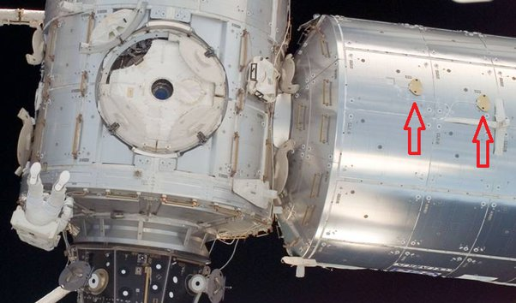
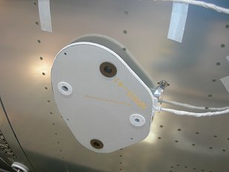
Three of the four antennas are identical and each can support both transmit and receive operations on 2 meter, 70 cm, L band and S band. They also support reception for the station's Russian Glisser TV system, which is used during spacewalks.

Slide 16
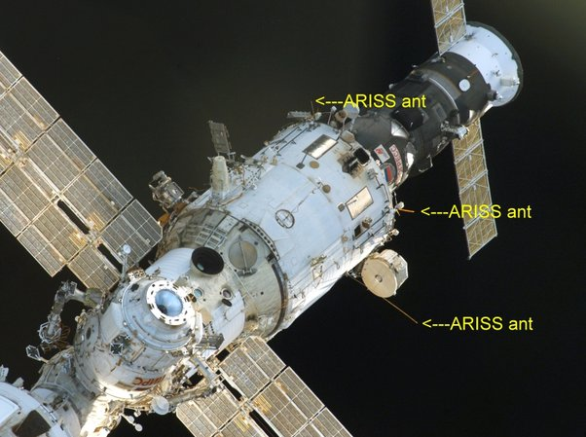

Slide 17
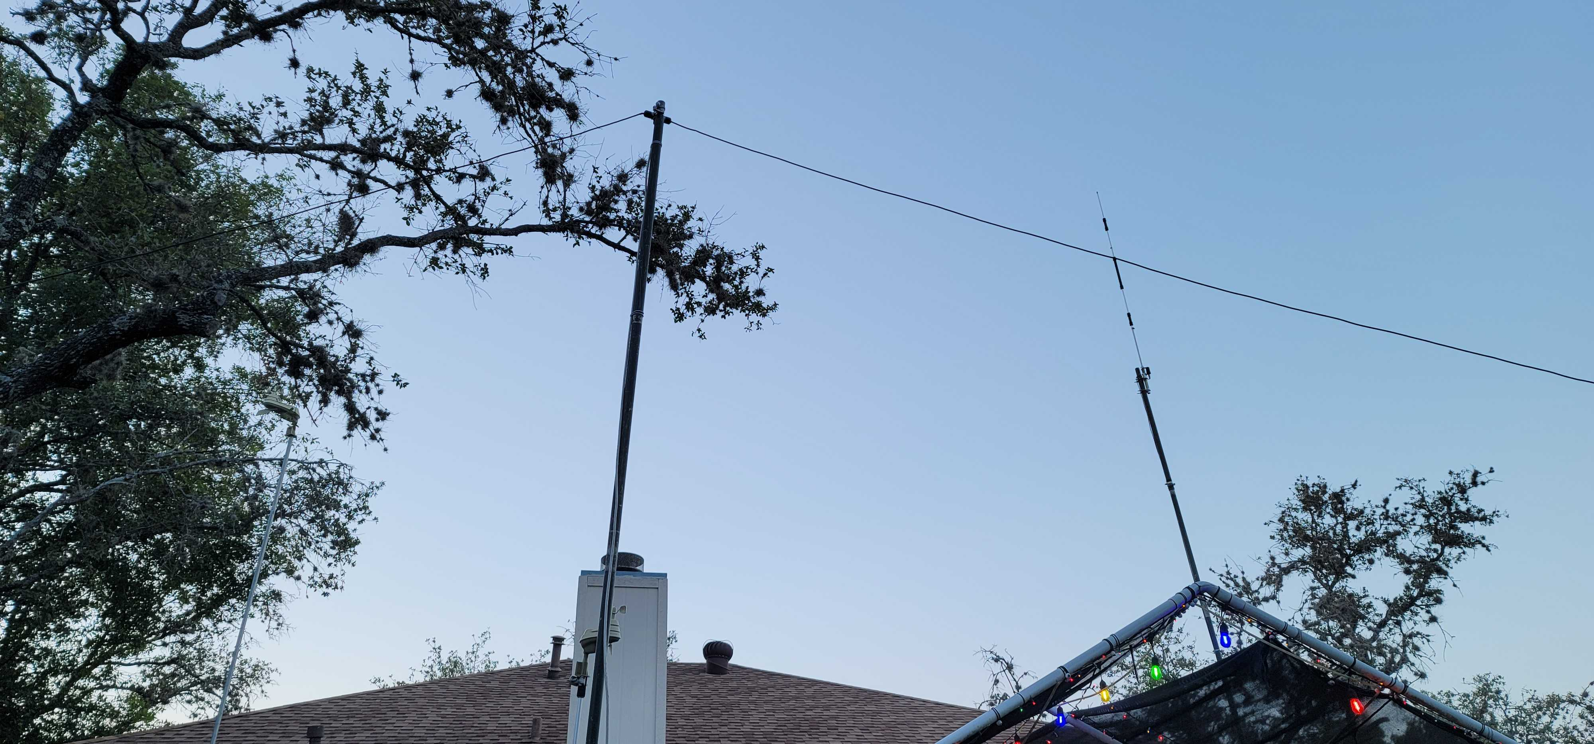

Slide 18
APRS on space station
145.825
Amateur Radio Stations heard via ISS
http://ariss.net/
https://www.n2yo.com/?s=25544&live=1
on Facebook
https://www.facebook.com/n2yodotcom

Slide 19
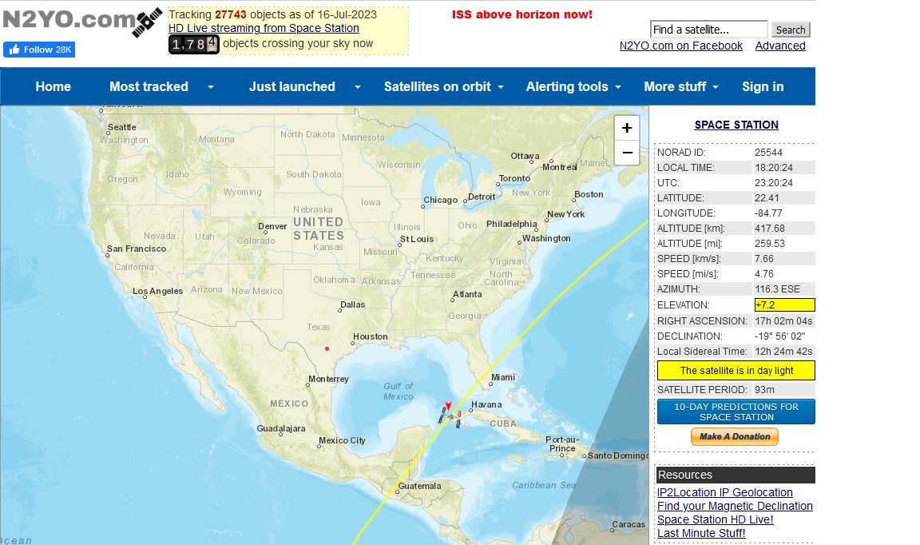

Slide 20
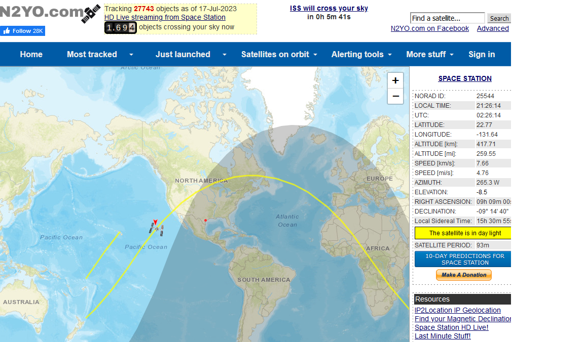

Slide 21
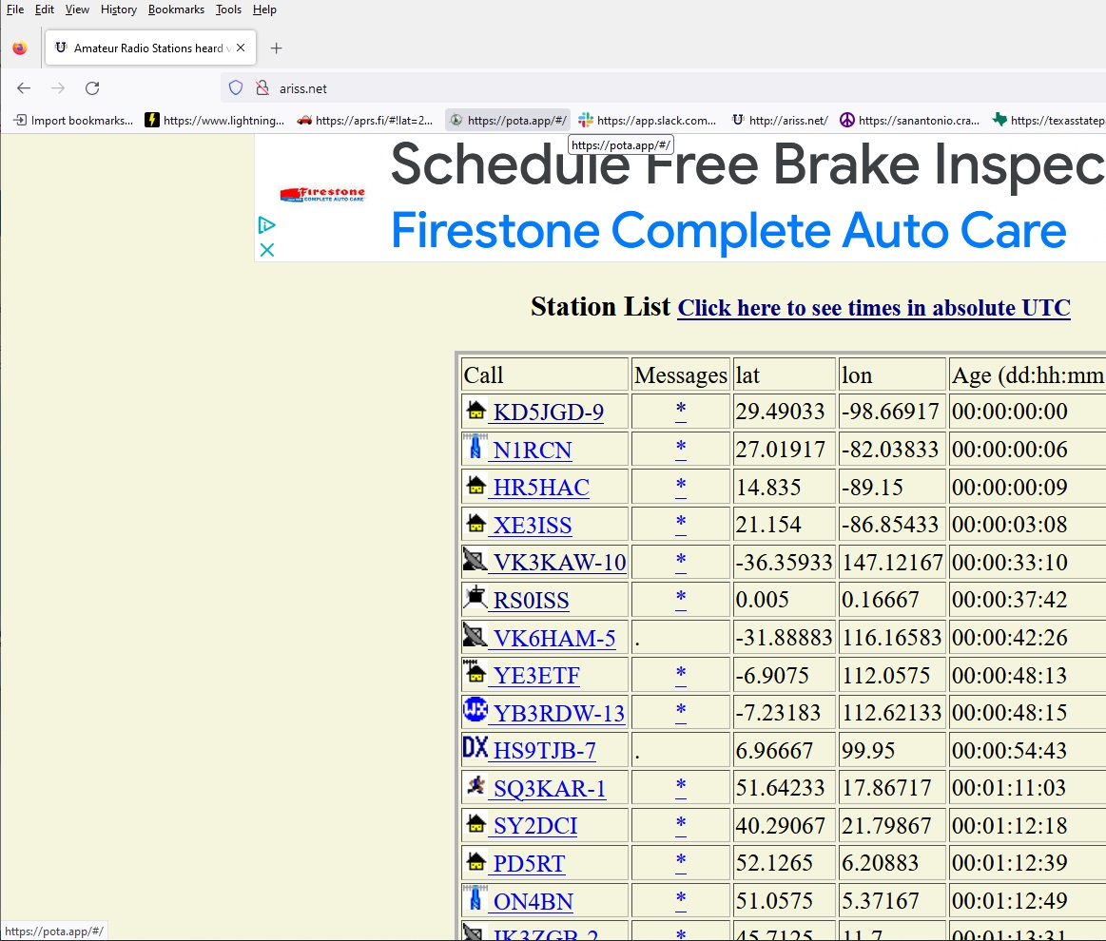

Slide 22
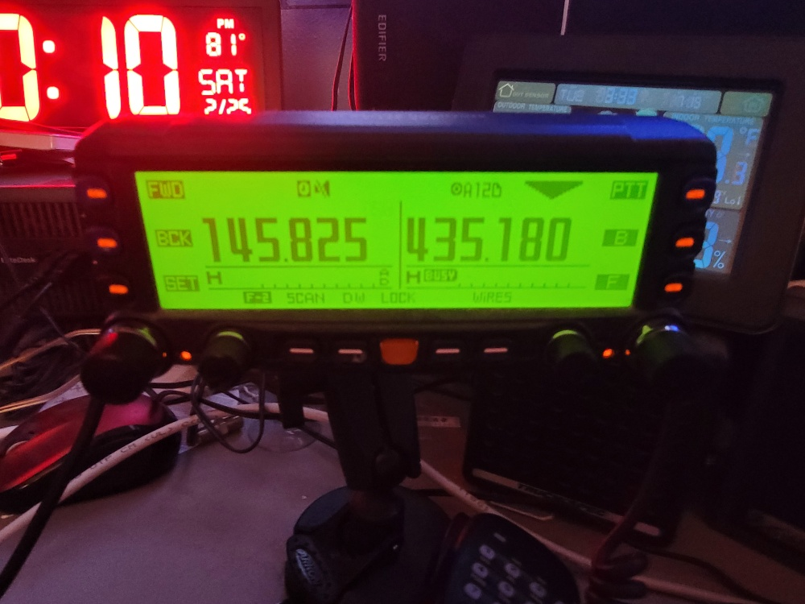

Slide 23
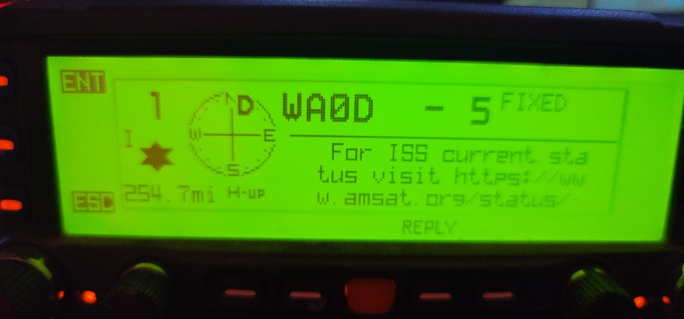

Slide 24
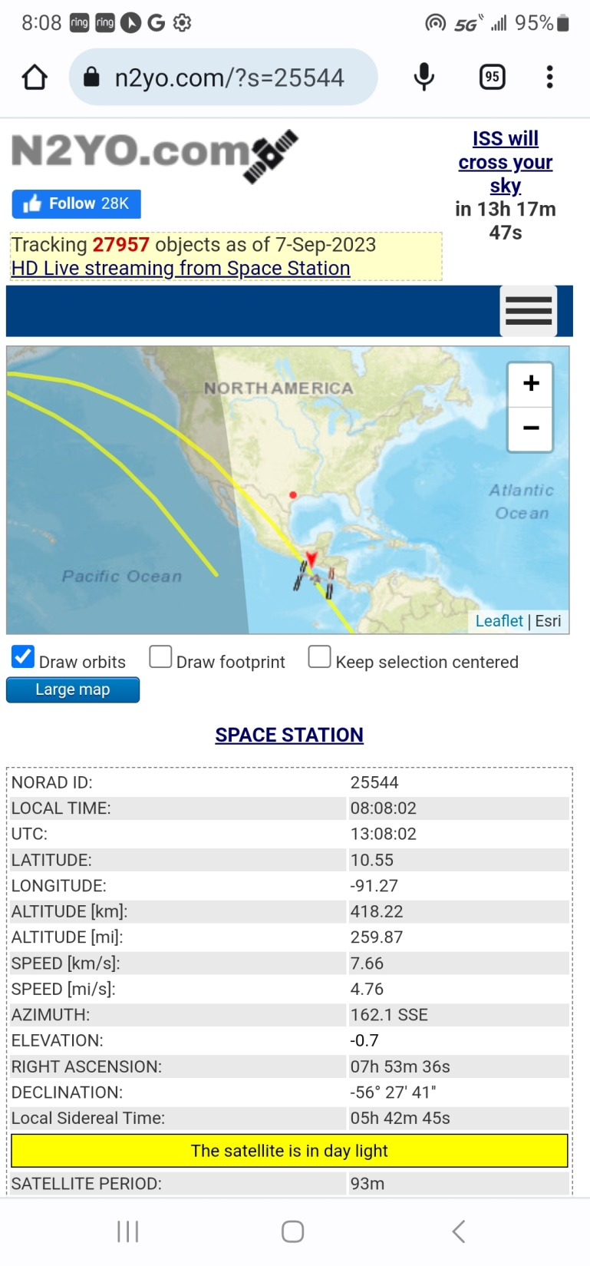

Slide 25
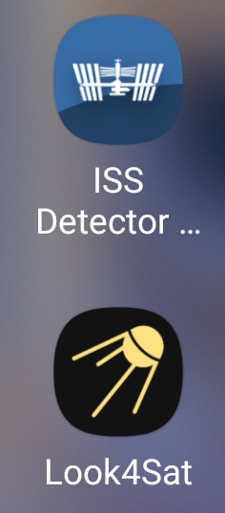

Slide 26
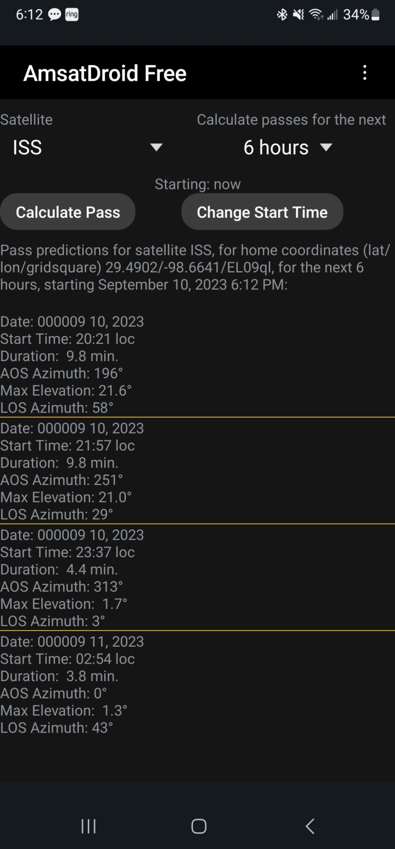

Slide 27
Travis Scott running
I emailed the dude in the audio from the video this is his set up. Travis Scott5:11 PM (2 hours ago)to me It’s hard to get it down-pat, but keep trying. It’s a lot of fun. I don’t know what your set up is, but I am using a handheld dual-band tape measure Yagi with my phone and attached two HT radios attached near the handle. I just record it using the audio recorder on the phone and write everything down afterwards.Sometimes the phone doesn’t perfectly track the satellite, but most of the time it gets me close enough. So-50 is also fun, and if you keep at the ISS, you might catch the astronauts!Also I don’t have a cross polarized antenna setup, I know that’ll help a lot.Hope to catch you on soon!Travis Scott

Slide 28
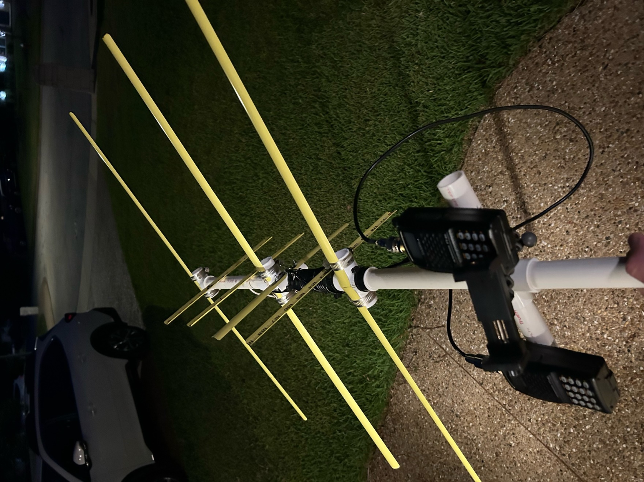

Slide 29
What Chris KH2PM running
Hi Keith,
I'm running about 25 watts from a Kenwood TM-D710G, and a Diamond 2m/70cm vertical about 20' above the ground. Nothing special.
When the ISS is out over the ocean there is less activity on the uplink and downlink. And a vertical antenna is better at getting into the ISS when it is low on the horizon, as it was earlier.
Chris KH2PM

Slide 30
What Matthew Palmeri running
Sun, Aug 13, 7:01 PM
to me
Hey Keith,
No problem - I have not played with any other satellites because the ISS is so reliable and I can usually hear it multiple times per day. I know there are other FM satellites just haven’t ventured out much.
In the few months I’ve been doing this I have spoken with NA1SS twice which, as far as I’m concerned, is the coolest thing I’ve done in my time as a ham!
Respectfully,
Matthew B. Palmeri

Slide 31
Hey Keith,
Thanks very much for reaching out for the SWL report! I’ve only been doing ISS repeater work (voice and APRS) for a few months now and it’s surprisingly easy.
With respect to my mobile setup - I was using a Yaesu FTM-500DR @ 50 watts with a DIAMOND SG-7900A-NMO antenna vertically mounted on the hood of my truck. I have the ISS FM voice repeater set up at a regular memory channel in split mode in VFO A then in VFO B I have the ISS APRS frequency. I have VFO A scanning my normal frequencies and I have VFO B set on the ISS APRS frequency with the proper configuration. Usually I will start picking up ISS APRS traffic on VFO B which is a good indicator that voice will soon follow. Once the ISS FM repeater channel breaks squelch on VFO A I open the squelch and get ready to copy. I do not compensate for doppler effect while I’m mobile which shortens my usable window but as you can see it still works fine. I find that the ISS voice signal tends to fade in, become strong, then fade out for a minute then fade back to strong before trailing off.
The FTM-500DR is good because it allows me to do APRS and voice simultaneously with no operator input needed but you can certainly achieve the desired outcome with any dual band radio (that offers split offset) with APRS and dual receive.
Hopefully my explanation was helpful – feel free to reach out with any questions. I’m learning how this works too!
VRY 73 DE AE2MP

Slide 32
Audio File of Pass

