Slide 1
Yaesu WIRES-X Demonstration
“Brief” Explanation and Overview
Demonstration
Questions
Unrelated Follow-on Information and Demonstration: RemoteHams and RCForb Client
20240313, KC3MVS/W5

Slide 2
What is WIRES-X?
WIRES-X (Wide-Coverage Internet Repeater Enhancement System) is a comprehensive and “easy-to-use” system for linking repeaters and/or home stations together, using Internet voice technology. Now you can talk to old friends, or make new ones, around the world.
For WIRES-X, an amateur node station connecting to the Internet is used as the access point and connects the wireless communication to the Internet.
Using the WIRES-X Portable Digital Node (PDN) function, you can operate a WIRES-X digital node station by directly connecting a Portable Digital Node-capable C4FM digital transceiver with a PC.

Slide 3
Yaesu PDN C4FM Radios
Yaesu C4FM Portable Digital Node-capable transceivers include the FT70, FT5D, FT3D, FT2D, FTM-500D, FTM-400XD, FTM-300D, FTM-200D,FTM-100D

Slide 4
Here come the terms and diagrams

Slide 5
Who doesn’t like Venn Diagrams?
System Fusion
System
Fusion
Repeaters
Wires-X
(Using the Internet)
C4FM
(Over the air or Internet)
PDN
Nodes

Slide 6
System Fusion, C4FM and WIRES-X
System Fusion is Yaesu’s digital communications mode for voice and data, including pictures. It utilizes a customized, yet open, C4FM FDMA standard.
C4FM stands for Continuous Four Level Frequency Modulation, which is a special type of 4FSK, which is used in conjunction with FDMA - Frequency Division Multiple Access.
Yaesu System Fusion allows a repeater trustee, club or group to install a Digital Repeater that is also analog, thus eliminating the need for an extra frequency pair to perform digital communications.
By using the System Fusion DR-1X Repeater, the trustee can add Digital AND Analog capabilities to an existing 2-Meter or 70CM Repeater pair without the need for an additional frequency pair that is dedicated to Digital Only communications.

Slide 7
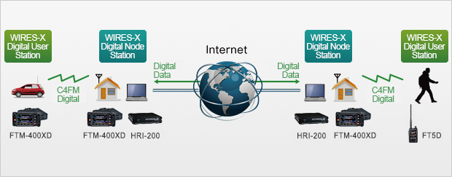
Sample WIRES-X Scenario
For WIRES-X, an amateur node station connecting to the Internet is used as the access point and connects the wireless communication to the Internet. Users' stations can communicate with other amateur stations all over the world using a node within the radio wave range.

Slide 8
More About Wires-X
Wires X – (Wide-coverage Internet Repeater Enhancement System) is an Internet communication system which expands the range of repeaters and nodes.
WIRES-X Node - An amateur “Node” station is where you use of one of Yaesu’s C4FM Fusion model radios connected to the internet using Yaesu’s software to link world-wide.
Amateur stations can communicate with other amateur stations using a node radio either on RF simplex or direct using a microphone. This is referred to as a PDN. (see next bullet below)
PDN – Personal Digital Node – Capable of using your own C4FM Fusion radio to connect to Wires X without going through a repeater.
A Wires X box (HRI-200) is only required when operating a room capable of having multiple connections generally used for repeater applications requiring several inbound connections.

Slide 9
Register with Yaesu to get a WIRES-X ID

Slide 10
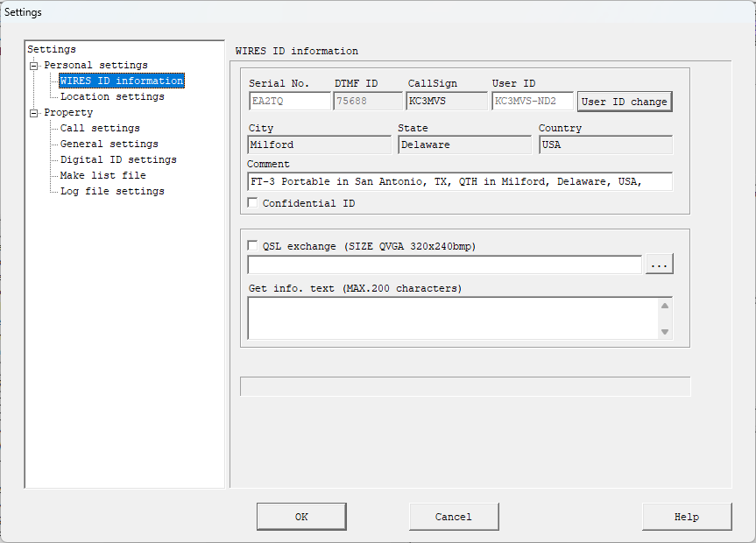
Wires-X Sample ID Information Screen

Slide 11
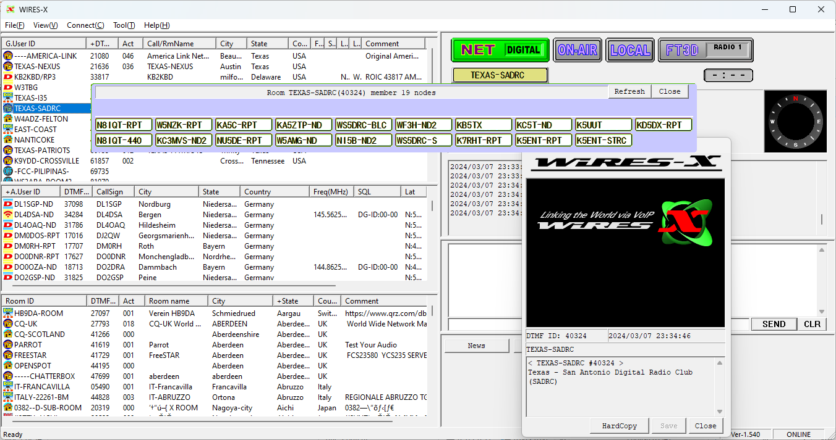
Wires-X Connection Screen Example

Slide 12
Wires-X Demonstration and Questions

Slide 13
Unrelated Follow-on Overview: RemoteHams and RCForb Client
Visit https://www.remotehams.com for information about remote ham radio setup and operation. RemoteHams server and RCForb Client software provides the capability to easily remotely control a ham radio station including an amplifier, antenna rotator, and switches.
The RCForb client software can be installed on PCs and Android phones. It integrates with popular logging programs and includes a keyboard keyer and DX cluster. An optional ORB Control Device is available to attach a PTT microphone and/or CW paddle.
Download and Install RCForb_Client.exe. You may download the latest version of RCForb (Client) from http://download.remotehams.com/.
Locate the downloaded file and double-click on “RCForb_Client.exe” to start setup.
You should now see a License Agreement dialog, review and accept.

Slide 14
Some of the Rules
Please Follow the Rules; or the radio owner will ban you!
* DO NOT tune an ORB without asking first.
* DO NOT 'take-over' an ORB as if it is your own.
* DO NOT relay any transmission heard to a 3rd party.
* DO NOT use any ORB for commercial purposes.
* DO NOT share your account information with others.
General Remote Usage Guidelines:
Respect Admins and TX Users. Users with an (A) or (X) on a remote have special access and control over regular users.
Ask To Tune Policy:
Please ask to tune the remote if someone else is present. If they do not respond within 2 minutes, feel free to tune. If they respond requesting you do not tune, please allow a maximum of 10 minutes for them to finish. Ignoring requests to tune from other users may result in you losing your tuning session. If you attempt to re-tune without allowing the new user 10 minutes to tune or do not ask to tune first, you may be "hi-jacking" the remote.
For remotes that have the "Ask To Tune" system enabled, this policy is enforced (You have to ask to tune.).

Slide 15
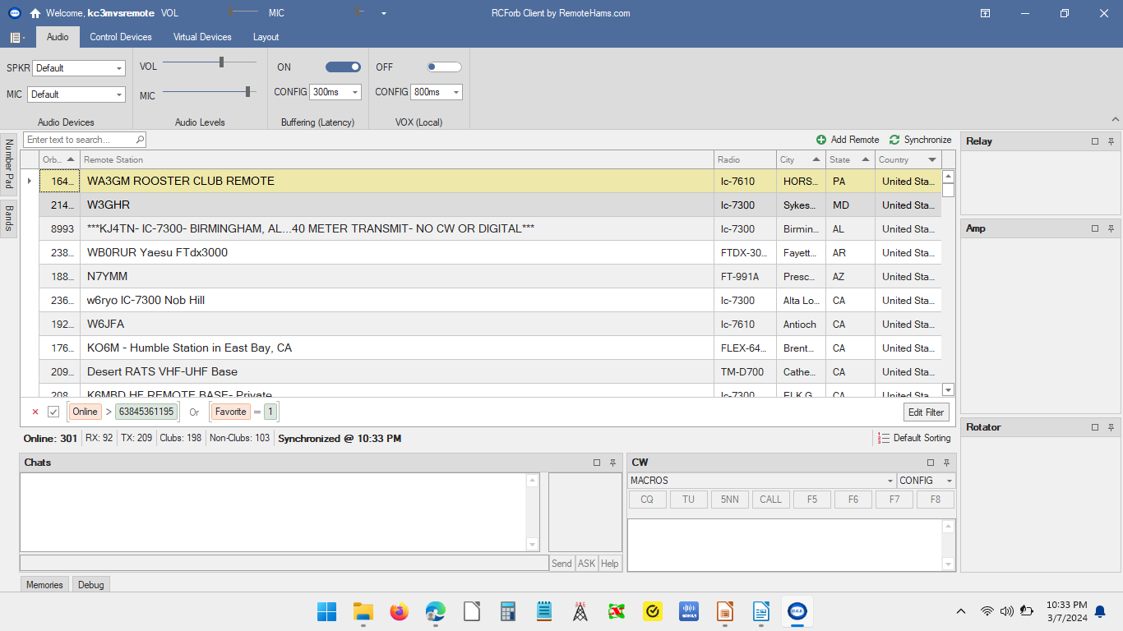
Sample List of Remote Radios (Servers)

Slide 16
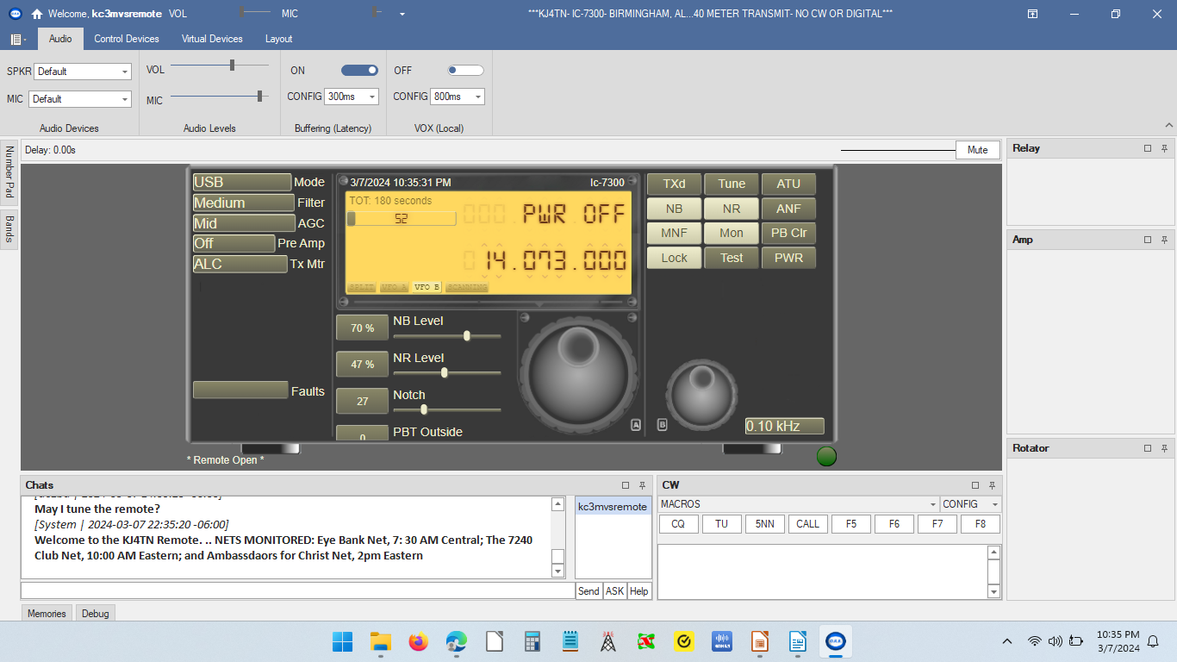
Sample Radio after Connecting

Slide 17
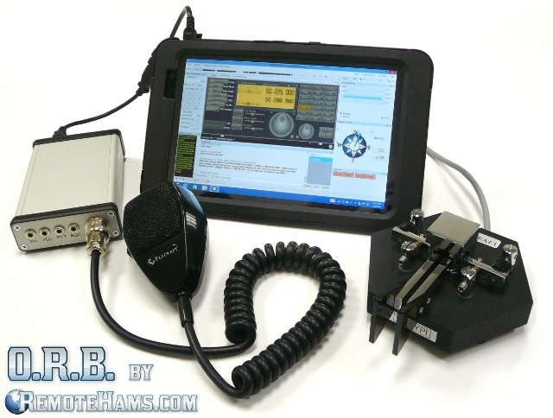
ORB Control Device
Portable Online Remote Base Solution by RemoteHams.com ($189.99)
Are you tired of using your keyboard or mouse for TX control? Talk on a remote using a microphone with PTT or pound away on your favorite paddle. Easily integrate digital mode or logging software to remotes on RemoteHams.com! Enjoy the added bonus of a built-in sound card for that full rich sound. All possible with a single USB connection to your PC.

Slide 18
RcForb Server
If you want to set up your radio to be a remote station for other hams to access, the RcForb server allows you to setup your own remote station on Remote Hams. Three connections to your transceiver are required, and an Internet connection.
The first required connection to your transceiver is is a CAT/CIV control. This is normally through a Serial Port connection. This connection operates the transceivers controls, frequency control, mode selection, filters, etc.
The next two connections are the audio connections to and from the transceiver and the computers sound card. You need to get the receivers audio to a Windows Record device (Line In or Microphone In) and a Windows Playback device to the radios Microphone Input. Some kind of audio isolation transformer needs to be in line with the latter. Most sound card interfaces on the market have this isolation transformer built in.
See http://beta.remotehams.com/orb/RCForb_Server_Manual.pdf for complete instructions.

Slide 19
Backup Slides:
Wires-X Illustrations, Terms and Definitions, thanks to Yaesu and the San Antonio Digital Radio Club

Slide 20
Terms & Definitions
● Node Radio (repeater or simplex) connected to the Internet via a PC, which
repeats communications from your local repeater connected to a Wires X
Room allowing multiple repeaters to connect in.
● Local Node (Simplex Station) This is a Node within the radio communication
range of a conventional amateur radio station. You can set up your own
simplex node and connect to any Wires X Room in the world using a windows
computer or tablet.
● Digital Node A Node which is a transceiver or repeater compatible with digital
communications in C4FM format. With this type of Node you can not only
relay voice communications but also text and image data. You can send
pictures and messages by purchasing a unique camera mic.
● Room This is a WIRES-X network community where multiple nodes
can connect simultaneously. Capable of voice, and text chat. Texas SADRC,
Texas Nexus, America Kansas City Wide are rooms capable of accepting
hundreds of repeater connections and/or PDN simplex node.

Slide 21
Terms & definitions
WIRES-X user ID (node) YAESU provides a numeric identification with the
WIRES-X node. Each node is assigned a DTMF ID (5-digit number, e.g.
(Texas SADRC 40324) and user ID (alphanumeric e.g. WB7OEV) up to 10
digits in length provided. Knowing the ID of the node to connect to, you can
transmit the DTMF ID code from the transceiver, specifying the node connect
to by searching by characters.
● ID List Nodes and room which currently operating WIRES-X. The list is stored
on a Yaesu server and is distributed to nodes over the WIRES-X network.
They are listed and published on the Yaesu website. The website shows
information such as IDs, the call sign and the operating frequency of the
node.
● WIRES-X Linked Repeater A repeater connected to the WIRES-X network. A
can be direct, or via an RF Link.
● Reflector - A reflector is a computer based server which connects Two (2) or more “
nodes" together via server. For example, using a RF Shark or Pi-Star, you can connect
into the Hondo repeater anywhere in the world by connecting to the YSF Reflector US
SADRC (Reflector #84398)

